Slide 1
Intro to Embedded Linux
Mohamed Saied

Slide 2
Agenda
What is Embedded Linux?
What is Real time System?
Is Linux a real time OS?
Scheduling
Multi-tasking
Linux Architecture

Slide 3
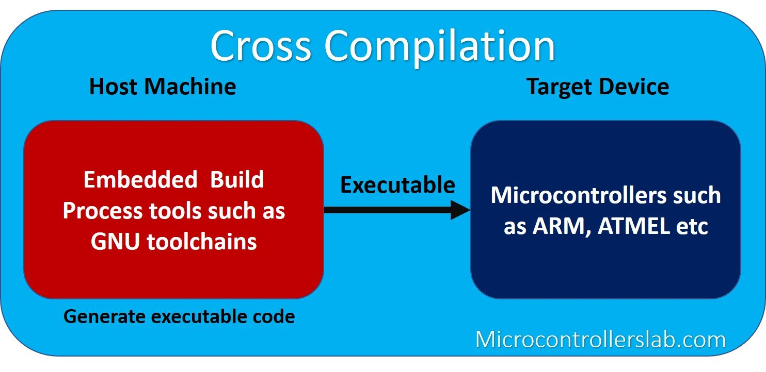

Slide 4
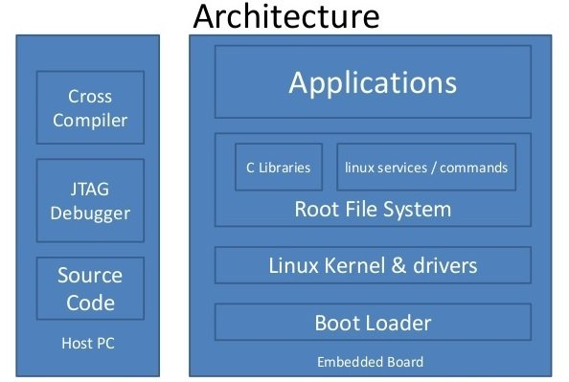
Embedded Linux Architecture
The embedded system build process is usually done on the host PC using cross-compilation tools. Because target hardware does not have enough resources to run tools that are used to generate a binary image for target embedded hardware. The process of compiling code on one system ( host system) and generated source code runs on the other system is known as cross-compilation.

Slide 5
Bootloader
Followings are the main roles of a bootloader:
Target hardware initialization
Load the application binary ( operating system, root file system, device tree ) from the non-volatile external storage to the RAM memory
RAM connects externally to the SOC and it stores run-time data, operating system, root file system, application software, and stack/heap.
After that execute the main operating system code from the RAM memory

Slide 6
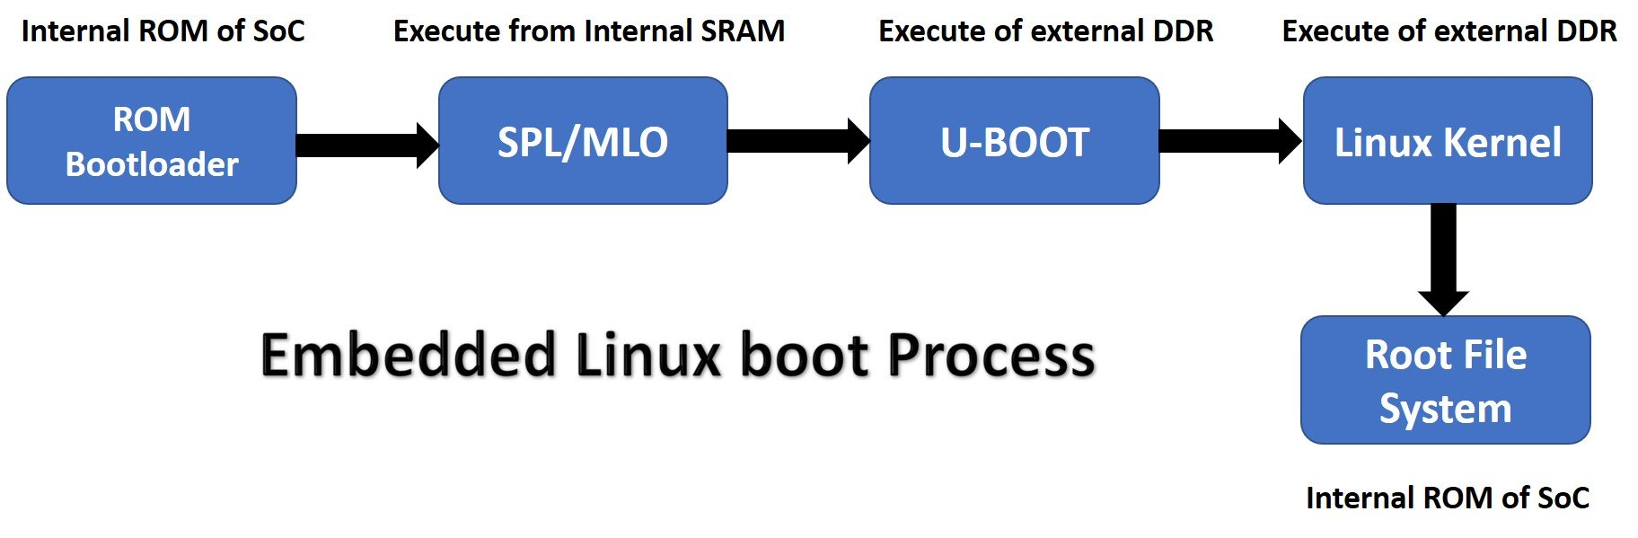
Embedded linux Process flow

Slide 7
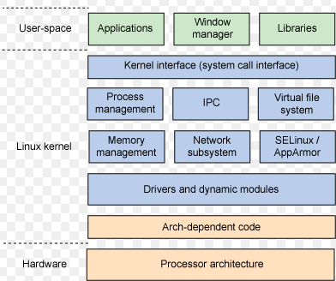
Linux Kernel
It is a software or operating system kernel that manages resources of embedded processors optimally and efficiently. The main core component of embedded Linux is the Linux Kernel. It is a layered operating system architecture that means it divides into two layers such as user space and kernel space memory space.

Slide 8
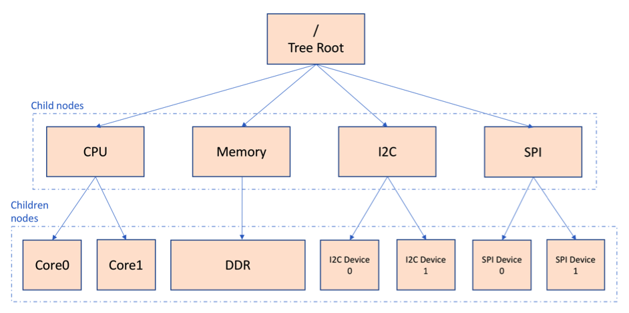
Device Tree
A device tree is a tree data structure that provides information about the connected hardware devices that are not discoverable themself and other on-chip peripherals of an SoC. Some of the automatically non-discoverable on-chip peripherals are I2C, UART, SP, ethernet, etc. On the contrary, the USB device has the capability or intelligence to inform its presence to the operating system dynamically

Slide 9
Device Tree Cont’
DT describes these devices using a special hardware description language. It decides which drivers to initialize and configure the device parameters such as registers addresses and IRQs. A DT source is combined with the Device Tree Blob and combines with the kernel during the embedded hardware booting process. The bootloader also loads the Device Tree Blob into RAM memory along with the Kernel and it runs before the kernel. In short, DT manages hardware resources of embedded Linux based systems.

Slide 10
Root File System

